Slide 1
Dog and cat identifier
Submitted by – Aayush Panwar 23SCSE1010569

Slide 2
Following code is used to represent the charts for dog and cat identifier system:-
import matplotlib.pyplot as plt
import numpy as np
# Sample data
num_dogs = 500
num_cats = 500
# -------- PIE CHART --------
labels = ['Dogs', 'Cats']
sizes = [num_dogs, num_cats]
colors = ['#ff9999','#66b3ff']
plt.figure(figsize=(5,5))
plt.pie(sizes, labels=labels, autopct='%1.1f%%', startangle=140, colors=colors, explode=(0.05, 0.05))
plt.title('Dataset Distribution')
plt.show()

Slide 3
# -------- BAR CHART --------
categories = ['Dogs', 'Cats']
counts = [num_dogs, num_cats]
plt.figure(figsize=(5,5))
plt.bar(categories, counts, color=['#ff9999','#66b3ff'])
plt.title('Number of Images per Class')
plt.xlabel('Class')
plt.ylabel('Number of Images')
plt.show()
# -------- LINE CHART --------
epochs = np.arange(1, 11)
train_accuracy = [0.60, 0.70, 0.78, 0.82, 0.85, 0.88, 0.90, 0.92, 0.93, 0.94]
val_accuracy = [0.58, 0.68, 0.75, 0.80, 0.83, 0.86, 0.88, 0.89, 0.90, 0.92]
plt.figure(figsize=(8,5))
plt.plot(epochs, train_accuracy, 'bo-', label='Training Accuracy')
plt.plot(epochs, val_accuracy, 'ro-', label='Validation Accuracy')

Slide 4
plt.title('Model Accuracy Over Epochs’)
plt.xlabel('Epochs’)
plt.ylabel('Accuracy’)
plt.ylim(0.5, 1.0)
plt.grid(True)
plt.legend()
plt.show()

Slide 5
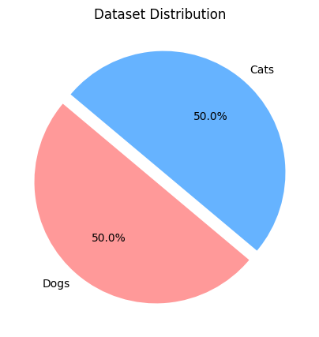
Pie chart:-

Slide 6
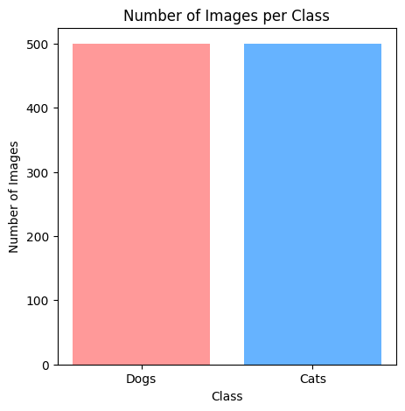
Bar chart:-

Slide 7
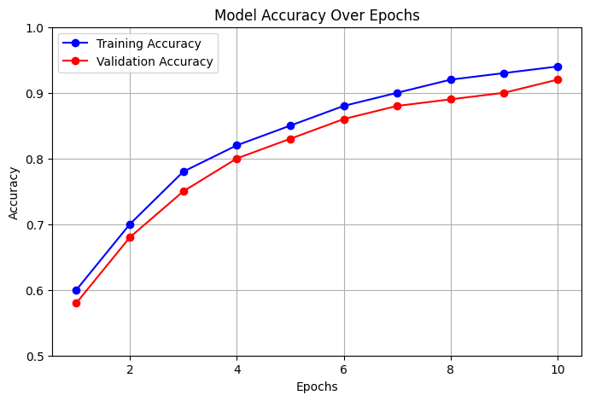
Line chart

Slide 8
Flow chart
Dataset
↓
Data Preprocessing
↓
Model (CNN Architecture)
↓
Training & Validation
↓
Evaluation
↓
Deployment
↓
Dog 🐶 / Cat 🐱 Prediction

